Slide 1

File Compression Algorithm Using Huffman Coding
DSA PROJECT
Team Members:
Sandesh Kumar
Fatima Nasir Khan
Tasmiya Malik

Slide 2
Objectives
To create an algorithm that successfully reduces size of document
In current scenario of online life it has become vital to transfer important files with the help of the internet
There is a limit to the size of a file that can be transferred easily with the help of our home internets.
This algorithm will create lossless compression of a file that can be transferred from a sender to a receiver

Slide 3
Project work
Huffman Coding is a greedy algorithm
A normal character takes up 8 bits.
If we assign less number of bits to each character then we can save a lot of space.
It creates a frequency table of characters and then forms a tree from it.

Slide 4
Work (continued)
Then by using that tress it assigns some bits to each character and then that character is replaced by those binary bits.
Then those bits are transferred.
For example:
Take this string "Generating random paragraphs can be an excellent way for writers to get their creative flow going at the beginning of the day. The writer has no idea what topic the random paragraph will be about when it appears."

Slide 5
Frequency Table
Character | Frequency | Number of bits
T | 1 | 8
G | 1 | 8
e | 13 | 104
n | 9 | 72
r | 13 | 104
a | 18 | 144
i | 13 | 104
t | 15 | 120
g | 8 | 64
SPACE | 40 | 320

Slide 6
Frequency Table
Character | Frequency | Number of bits
l | 5 | 40
o | 7 | 56
d | 4 | 32
. | 1 | 8
p | 7 | 56
h | 9 | 72
x | 1 | 8
w | 6 | 48
y | 1 | 8
f | 2 | 16

Slide 7
Making the Code Tree
93
53
25
17
28
40
18
15
13
8
9

Slide 8
Binary Code Table
Character | Frequency | Number of original bits | Code | Number of bits
T | 1 | 8 | 11011111 | 8
G | 1 | 8 | 11011100 | 8
e | 13 | 104 | 001 | 39
n | 9 | 72 | 1000 | 36
r | 13 | 104 | 1010 | 52
a | 18 | 144 | 010 | 54
i | 13 | 104 | 0111 | 52
t | 15 | 120 | 1011 | 60
g | 8 | 64 | 11000 | 40
SPACE | 40 | 320 | 111 | 120

Slide 9
Binary Code Table
Character | Frequency | Number of original bits | Binary Code | Number of bits
l | 5 | 40 | 01100 | 25
o | 7 | 56 | 0000 | 28
d | 4 | 32 | 110010 | 24
. | 1 | 8 | 1101101 | 7
p | 7 | 56 | 10010 | 35
h | 9 | 72 | 0001 | 36
x | 1 | 8 | 11011101 | 8
w | 6 | 48 | 10011 | 30
y | 1 | 8 | 1101100 | 7
f | 2 | 16 | 011010 | 12

Slide 10
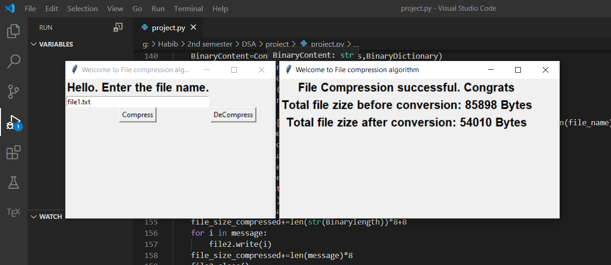

Slide 11
Used data structures and techniques in Program
1:Trees
2:Stacks
3:Dictionaries
4:Huffman Algorithm
5:Binary to character conversion
6:Character to Binary Conversion
7:Tkinter Library

Slide 12
Key challenges and issues
1: Binary code can't be written on txt files.
2: Txt files don't recognize characters of 8 bit
3: Work environment and internet issues

Slide 13
Output/Results
This algorithm is working well and is completed
We have used it on some of our Modernity essays and the file uploaded by Miss Aisha for HW 2 and all of them were compressed easily.

